Slide 1
CS3212 計算機網路概論 Winsock Tutorial

Slide 2
Dev C++ environment setting
Download Dev-C++ from http://www.bloodshed.net/devcpp.html
Orwell Dev-C++ 5.11 (Recommended)
http://orwelldevcpp.blogspot.tw/2015/04/dev-c-511-released.html
Scheme 1
Scheme 2

Slide 3
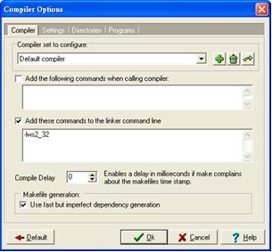
Dev C++ Scheme 1: No project
Tools → Compiler Options → Add “-lws2_32” to the linker command line
File → New → Source File
#include <winsock2.h>

Slide 4
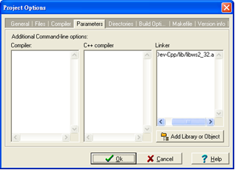
Dev C++ Scheme 2: Use project
File → New → Project
Choose “Console Application”
Project → Project Options → Parameters
Add Library or Object
Choose C:\Dev-Cpp\lib\libws2_32.a
#include <winsock2.h>

Slide 5
CodeBlocks environment setting
Download CodeBlocks from http://www.codeblocks.org/downloads
Not recommended in Windows 10
Scheme 1
Scheme 2

Slide 6
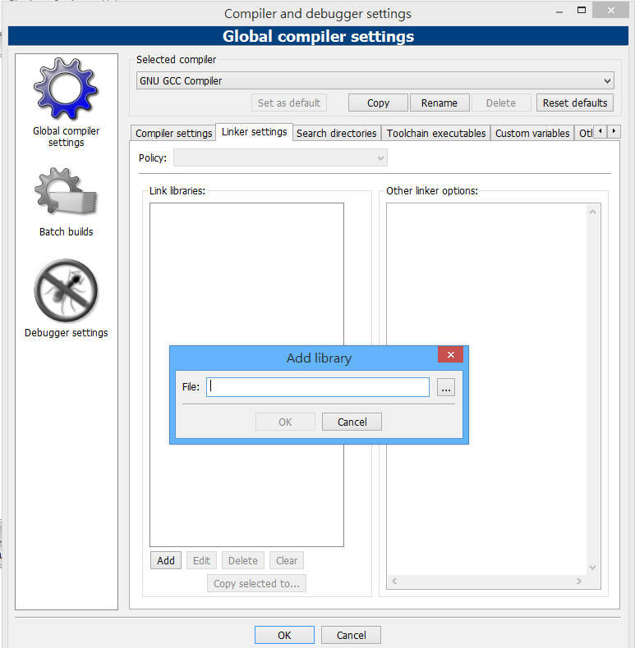
CodeBlocks Scheme 1: No project
Settings → Compiler and debugger → Linker Settings
Choose C:\Program Files (x86)\CodeBlocks\MinGW\libws2_32.a
File → New → Source File
#include <winsock2.h>

Slide 7
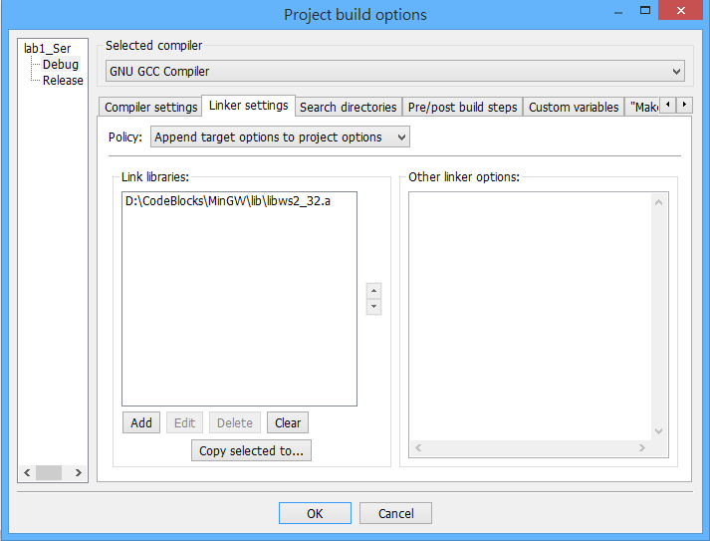
CodeBlocks Scheme 2: Use project
File → New → Project
Right click project → Build Option→ Linker Settings
Choose C:\Program Files (x86)\CodeBlocks\MinGW\libws2_32.a
#include <winsock2.h>

Slide 8
Scheme 1: Use CMD
gcc -o cli TCP_echo_client.c -lws2_32
gcc -o ser TCP_echo_server.c -lws2_32

Slide 9
Socket programming
TCP flow chart
UDP flow chart
Data structure of address
Functions

Slide 12
Data structure of address
sin_addr.s_addr = inet_addr(“127.0.0.1”); (for client)
The htons function converts a u_short from host to TCP/IP network byte order (which is big-endian).
Notes:
設置地址時應該用AF_INET

Slide 13
Functions
WSAStartup(MAKEWORD(2,2),(LPWSADATA)&wsadata) Load winsock of version 2.2
WSACleanUp() Release winsock
socket(PF_INET, SOCK_STREAM, 0) Create a TCP socket (SOCK_STREAM) or UDP socket (SOCK_DGRAM)
bind(serverSocket, (struct sockaddr *)&serverAddress, sizeof(serverAddress) Assign serverSocket serverAddress
listen(serverSocket, 3) Prepare for incoming connections (maximum 3 connections)

Slide 14
accept(serverSocket, (struct sockaddr *)&clientAddress, &clientAddressLen) Create a socket for the incoming connection, and the address of the target host is stored in clientAddress
closesocket(serverSocket) Close serverSocket
send(serverSocket, buf, len, 0) Send buf of size len (TCP socket)
recv(serverSocket, buf, MAX_SIZE, 0) Receive data of maximum size MAX_SIZE, and store the data in buf (TCP socket)

Slide 15
Examples
TCP echo server/client

